Slide 1
Polymorphism in Java

Slide 2
Polymorphism
Polymorphism in java is a concept by which we can perform a single action by different ways. Polymorphism is derived from 2 greek words: poly and morphs. The word "poly" means many and "morphs" means forms. So polymorphism means many forms.

Slide 3
Polymorphism
Polymorphism is another special feature of object-oriented programming (OOPs). The approach which lies beneath this concept is “single interface with multiple implementations This offers a single interface for controlling access to a general class of actions
Polymorphism can be achieved in two of the following ways:
Method Overloading(Compile time Polymorphism)
Method Overriding(Run time Polymorphism)

Slide 4
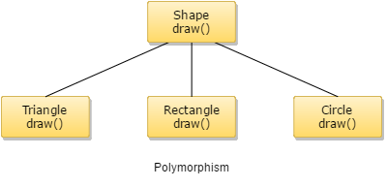
Types of polymorphism
There are two types of polymorphism in java: 1) Static Polymorphism also known as compile time polymorphism 2) Dynamic Polymorphism also known as runtime polymorphism

Slide 5
Compile time Polymorphism
Compile time Polymorphism (or Static polymorphism)
Polymorphism that is resolved during compiler time is known as static polymorphism. Method overloading is an example of compile time polymorphism.
Method Overloading: This allows us to have more than one method having the same name, if the parameters of methods are different in number, sequence and data types of parameters.

Slide 6
Example of static Polymorphism
Method overloading is one of the way java supports static polymorphism. Here we have two definitions of the same method add() which add method would be called is determined by the parameter list at the compile time. That is the reason this is also known as compile time polymorphism.

Slide 7
Method Overloading
To call an overloaded method in Java, it is must use the type and/or the number of arguments to determine which version of the overloaded method to actually call.
The overloaded methods may have varied return types and the return type single-handedly is insufficient to make out two versions of a method.

Slide 8
Method Overloading
As and when Java compiler encounters a call to an overloaded method, it simply executes the version of the method whose parameters match the arguments used in the call.
It permits the user to obtain compile time polymorphism with name method name.
An overloaded method is able to throw different kinds of exceptions.
A method which is overloaded can contain different access modifiers.

Slide 9
Variations in Overloading a Method
Overloading method’s argument lists might differ in:
Number of parameters passed
Data type of actual parameters
Sequence of data type of actual parameters

Slide 10
Program for Method Overloading in Java
class Mltply
{
void mul(int a, int b)
{
System.out.println("Sum of two=" + (a * b));
}
void mul(int a, int b, int c)
{
System.out.println("Sum of three=" + (a * b * c));
}
}
class Polymorphism
{
public static void main(String args[])
{
Mltply m = new Mltply();
m.mul(6, 10);
m.mul(10, 6, 5); } }

Slide 11
Method Overriding
Argument list: The argument list at the time of overriding method need to be same as that of the method of the parent class. The data types of the arguments along with their sequence must have to be preserved as it is in the overriding method.
Access Modifier: The Access Modifier present in the overriding method (method of subclass) cannot be more restrictive than that of an overridden method of the parent class.

Slide 12
Method Overriding
The private, static and final methods can’t be overridden as they are local to the class.
Any method which is overriding is able to throw any unchecked exceptions, in spite of whether the overridden method usually method of parent class might throw an exception or not.

Slide 13
Program for Method Overriding in Java
class parent
{
public void work()
{
System.out.println("Parent is under retirement from work.");
}
}
class child extends parent
{
public void work()
{
System.out.println("Child has a job");
System.out.println(" He is doing it well");
}
public static void main(String argu[])
{
child c1 = new child(); c1.work();
}
}

Slide 14
Advantage of method overriding
One major advantage of method overriding is that a class can give its own specific execution to an inherited method without having the modification in the parent class (base class).

Slide 15
Runtime Polymorphism (or Dynamic polymorphism)
class ABC
{
public void myMethod()
{
System.out.println("Overridden Method");
}
}
public class XYZ extends ABC
{
public void myMethod()
{
System.out.println("Overriding Method");
}
public static void main(String args[])
{
ABC obj = new XYZ();
obj.myMethod();
}
}

Slide 16
Super keyword in java
The super keyword in java is a reference variable which is used to refer immediate parent class object.
Whenever you create the instance of subclass, an instance of parent class is created implicitly which is referred by super reference variable.

Slide 17
Usage of java super Keyword
super can be used to refer immediate parent class instance variable.
super can be used to invoke immediate parent class method.
super() can be used to invoke immediate parent class constructor.

Slide 18
super is used to refer immediate parent class instance variable
class Animal{
String color="white";
}
class Dog extends Animal{
String color="black";
void printColor(){
System.out.println(color);//prints color of Dog class
System.out.println(super.color);//prints color of Animal class
}
}

Slide 19
class TestSuper1{
public static void main(String args[]){
Dog d=new Dog();
d.printColor();
}}
Output
black
white

Slide 20
super can be used to invoke parent class method
class Animal{
void eat(){System.out.println("eating...");}
}
class Dog extends Animal{
void eat(){System.out.println("eating bread...");}
void bark(){System.out.println("barking...");}
void work(){
super.eat();
bark();
}
}

Slide 21
class TestSuper2{
public static void main(String args[]){
Dog d=new Dog();
d.work();
}}
output
eating...
barking...

Slide 22
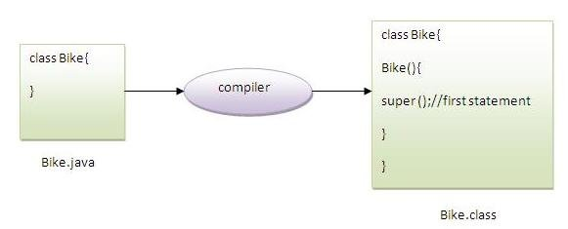
Note: super() is added in each class constructor automatically by compiler if there is no super() or this().

Slide 23
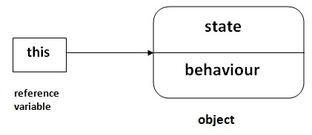
this keyword in java
There can be a lot of usage of java this keyword. In java, this is a reference variable that refers to the current object.

Slide 24
Usage of java this keyword
Here is given the 6 usage of java this keyword.
this can be used to refer current class instance variable.
this can be used to invoke current class method (implicitly)
this() can be used to invoke current class constructor.
this can be passed as an argument in the method call.
this can be passed as argument in the constructor call.
this can be used to return the current class instance from the method.
Suggestion: If you are beginner to java, lookup only three usage of this keyword

Slide 25
this: to refer current class instance variable
The this keyword can be used to refer current class instance variable. If there is ambiguity between the instance variables and parameters, this keyword resolves the problem of ambiguity.

Slide 26
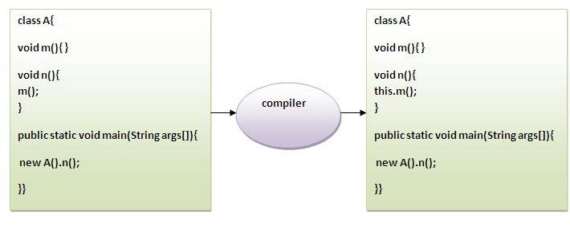
this: to invoke current class method
You may invoke the method of the current class by using the this keyword. If you don't use the this keyword, compiler automatically adds this keyword while invoking the method. Let's see the example

Slide 27
hello n hello m
class A{
void m(){System.out.println("hello m");}
void n(){
System.out.println("hello n");
//m();//same as this.m()
this.m();
}
}
class TestThis4{
public static void main(String args[]){
A a=new A();
a.n();
}}
Output
hello n
hello m

Slide 28
this()
this() : to invoke current class constructor
Real usage of this() constructor call
Rule: Call to this() must be the first statement in constructor.
this: to pass as an argument in the method
this: to pass as argument in the constructor call
this keyword can be used to return current class instance

Slide 29
Syntax of this that can be returned as a statement
return_type method_name()
{
return this;
}

Slide 30
Example of this keyword that you return as a statement from the method
class A{
A getA(){
return this;
}
void msg(){System.out.println("Hello java");}
}
class Test1{
public static void main(String args[]){
new A().getA().msg();
}
}
Hello java

Slide 31
End of Session - 9 Thank You !

